Slide 1
MOUNT SALEM CHRISTIAN
SCHOOL
April 2022

Slide 2
HISTORY
Mount Salem Christian School was founded in 1987 and started operating out of the Mount Salem EMC Sunday School wing. In order to begin lessons, a couple parents canvassed the local public schools for books and school supply donations. In 1990 the school purchased its own set of books and with a couple curriculum changes, has been providing a high academic teaching since 1992.
MOUNT SALEM CHRISTIAN SCHOOL | BARIBEAU CONSTRUCTION

Slide 3
HISTORY
In 1994, the MSCS Constitution was created and with half of the families at that time coming from different churches, a school family elected board was put in place to assist in operating the school. At present, MSCS is a non-denominational school representing almost 20 local churches and the Board consists of 7 parent or community volunteers, the principal and vice principal.
MOUNT SALEM CHRISTIAN SCHOOL | BARIBEAU CONSTRUCTION

Slide 4
HISTORY
MSCS continued to grow and the concern for space was evident. In 1999 a custom built, two classroom portable was set up, followed by another one in 2000 and by 2002 the school had eight of its own portable classrooms. Still with limited space, the high school grades were taken 7km to the Sommerfeld Mennonite Church (SMC), but were moved back on the main campus in the fall of 2006. SMC built a new church in Mount Salem within walking distance from the school, and graciously allowed our high school to operate out of there starting in 2008.
MOUNT SALEM CHRISTIAN SCHOOL | BARIBEAU CONSTRUCTION

Slide 5
HISTORY
In 2003 students started participating in CAASO (Christian Athletic Association of Southern Ontario) in a variety of sports such as soccer, cross country, volleyball, basketball, floor hockey, track & field and baseball. The students love sports and participating in the tournaments, but we dream of one day having our very own gym to practice and play in. For now, we continue to rely on weather and the pad of pavement that was poured in 2002.
MOUNT SALEM CHRISTIAN SCHOOL | BARIBEAU CONSTRUCTION

Slide 6
HISTORY
By 2012, the school had plans to erect their very own building on the 10.5 acres they had purchased just next door. The site plan was completed and a well was dug, but a way to fund the project was never established and so the school continued to operate out of the church wing and portables.
MOUNT SALEM CHRISTIAN SCHOOL | BARIBEAU CONSTRUCTION

Slide 7
HISTORY
MSCS first high school graduation was in 2000. By 2005, the school was in partnership with the Independent Learning Centre and students began receiving their Ontario Secondary School Diploma (OSSD). Yet, with the lack of space and course options, several families began pulling out and sending their children to the local public schools, resulting in the difficult decision to close the high school in 2016.
MOUNT SALEM CHRISTIAN SCHOOL | BARIBEAU CONSTRUCTION

Slide 8
HISTORY
MSCS continued to grow, and a fulltime resource teacher was hired in 2017 which drew many new families to the school, and in 2019 fulltime kindergarten became an option. We continue to see growth and a well-rounded education, most years well above the Canadian Testing Center average in both math and reading.
MOUNT SALEM CHRISTIAN SCHOOL | BARIBEAU CONSTRUCTION

Slide 9
HISTORY
Today MSCS has 187 students from 93 families. 14 full time staff, 3 part time staff and dozens of volunteers to help operate our hot lunch programs, assist in sports and chaperone field trips.
Currently we have 182 students enrolled for our next school year.
MOUNT SALEM CHRISTIAN SCHOOL | BARIBEAU CONSTRUCTION

Slide 10
HISTORY
Sharing by Anita Thiessen
MOUNT SALEM CHRISTIAN SCHOOL | BARIBEAU CONSTRUCTION

Slide 11
VISION
To continue to provide a high level of Bible based academic instruction and to partner with parents as we educate the whole child, equipping and training the student for a life of obedience to their calling in this world as an image-bearer of Jesus Christ
MOUNT SALEM CHRISTIAN SCHOOL | BARIBEAU CONSTRUCTION

Slide 12
VISION
We do not want to look at MSCS as just a school, but rather a Missions Training Field.
We want a connection to continue, between family and school, as well as student and school. We want you to come back with/for your children and with/for your grandchildren.
MOUNT SALEM CHRISTIAN SCHOOL | BARIBEAU CONSTRUCTION

Slide 13
VISION
We want our students to have a strong foundation rooted in Christ when they graduate MSCS.
We pray that it will only grow and strengthen as they leave and go out into the world and share the love of Christ with those they meet in college, university or at work making every place their mission field to Christ
MOUNT SALEM CHRISTIAN SCHOOL | BARIBEAU CONSTRUCTION

Slide 14
VISION
Sharing by Abe Redecop
MOUNT SALEM CHRISTIAN SCHOOL | BARIBEAU CONSTRUCTION

Slide 15
VISION
Building a new elementary school on the current school property
(Next door to existing school location)
MOUNT SALEM CHRISTIAN SCHOOL | BARIBEAU CONSTRUCTION

Slide 16
VISION
MSCC has been a huge part of this school from the very beginning and a big blessing.
We are thankful for their continued support and relationship with MSCC.
As we step out on our own, we are excited to grow our school community and see our dreams become reality.
MOUNT SALEM CHRISTIAN SCHOOL | BARIBEAU CONSTRUCTION

Slide 17
VISION
Building will provide larger classrooms for larger enrollment of students from JK to Grade 8
Extra space for labs, additional curricular options (science lab, art room etc..) library and chapel space
MOUNT SALEM CHRISTIAN SCHOOL | BARIBEAU CONSTRUCTION

Slide 18
VISION
Gymnasium - with change rooms (we hope to be able to rent this space out for additional income to families, homeschool groups )
(Due to the location of our school, we may not be hosts for any of our school related sports teams – CAASO)
Kitchen – possible cooking classes or class projects, special events and fundraisers, rental for additional income
MOUNT SALEM CHRISTIAN SCHOOL | BARIBEAU CONSTRUCTION

Slide 19
VISION
We want to see MSCS continue to grow in numbers.
We dream of a high school. We are hearing more and more the demand for a more local Christian high school
MOUNT SALEM CHRISTIAN SCHOOL | BARIBEAU CONSTRUCTION

Slide 20
HOW YOU CAN SUPPORT US
Sharing by Maria Dyck
MOUNT SALEM CHRISTIAN SCHOOL | BARIBEAU CONSTRUCTION

Slide 21
STEPS
Phase 1 – Elementary School – 22,769 sq ft – cost $5.3 million
Phase 2 – Gymnasium – 12,000 sq ft
– cost $2.8 million
Phase 3 – High School – 15,000 sq ft
– cost $3.5 million

Slide 22
HOW YOU CAN SUPPORT US
PRAYER!
this needs to be number one.
We are Building on Faith and trusting that God will provide what we need for this school.
MOUNT SALEM CHRISTIAN SCHOOL | BARIBEAU CONSTRUCTION

Slide 23
HOW YOU CAN SUPPORT US
Be excited with us!
Share about our project with friends, family & co-workers
This project will only go as far as we take it and believe in it.
MOUNT SALEM CHRISTIAN SCHOOL | BARIBEAU CONSTRUCTION

Slide 24
HOW YOU CAN SUPPORT US
Give! Fundraise! Pledge!
More on this later.
MOUNT SALEM CHRISTIAN SCHOOL | BARIBEAU CONSTRUCTION

Slide 25
The Project

Slide 26
North Exterior
MOUNT SALEM CHRISTIAN SCHOOL | BARIBEAU CONSTRUCTION

Slide 27
North Exterior
What you would see driving up from the road

Slide 28
South Exterior
MOUNT SALEM CHRISTIAN SCHOOL | BARIBEAU CONSTRUCTION

Slide 29
South Exterior
Back view – facing the woods

Slide 30
Elevation Drawing
MOUNT SALEM CHRISTIAN SCHOOL | BARIBEAU CONSTRUCTION

Slide 32
Multi-Purpose Space
MOUNT SALEM CHRISTIAN SCHOOL | BARIBEAU CONSTRUCTION

Slide 34
Main Hallway
MOUNT SALEM CHRISTIAN SCHOOL | BARIBEAU CONSTRUCTION

Slide 36
Main Hallway #2
MOUNT SALEM CHRISTIAN SCHOOL | BARIBEAU CONSTRUCTION

Slide 38
Classroom
MOUNT SALEM CHRISTIAN SCHOOL | BARIBEAU CONSTRUCTION

Slide 40
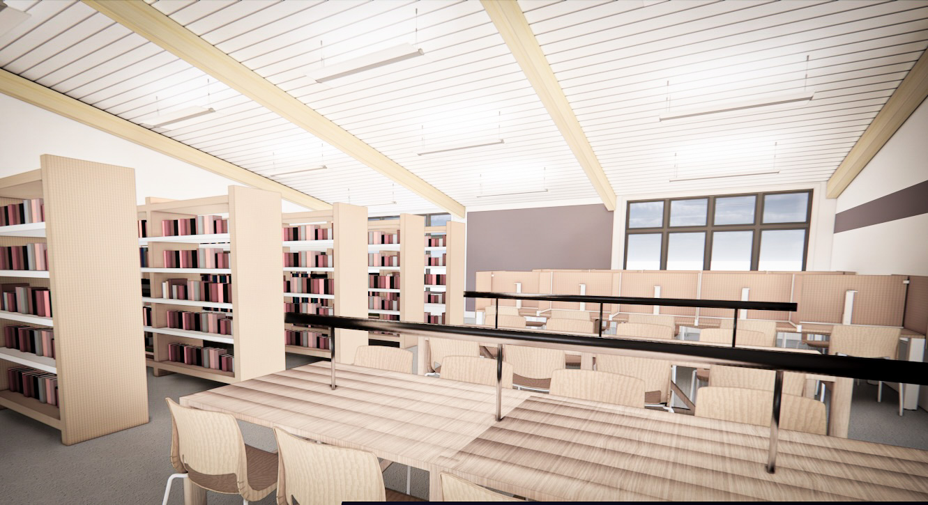
Library
MOUNT SALEM CHRISTIAN SCHOOL | BARIBEAU CONSTRUCTION

Slide 41
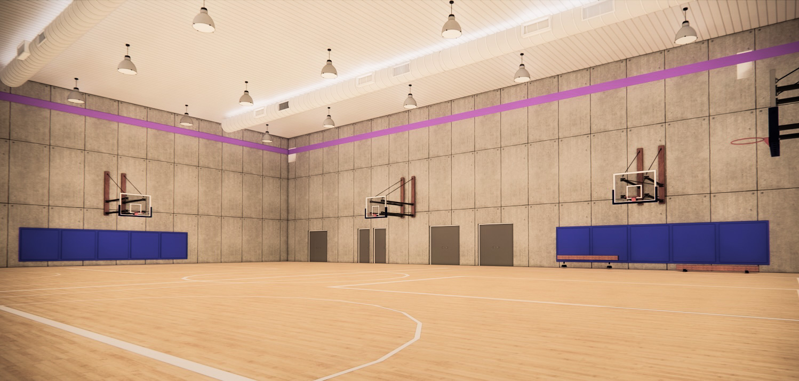
Gymnasium
MOUNT SALEM CHRISTIAN SCHOOL | BARIBEAU CONSTRUCTION

Slide 42
Phase 1 Siteplan
MOUNT SALEM CHRISTIAN SCHOOL | BARIBEAU CONSTRUCTION

Slide 44
Floor Plan (Phases 1-3)
MOUNT SALEM CHRISTIAN SCHOOL | BARIBEAU CONSTRUCTION

Slide 46
Mezzanine
MOUNT SALEM CHRISTIAN SCHOOL | BARIBEAU CONSTRUCTION

Slide 48
Phase 2 Siteplan
MOUNT SALEM CHRISTIAN SCHOOL | BARIBEAU CONSTRUCTION

Slide 50
All Phases – Colour Coded
MOUNT SALEM CHRISTIAN SCHOOL | BARIBEAU CONSTRUCTION

Slide 54
FUNDING
Donations
This is a multi million dollar project and money needs to come from every where possible. We are currently looking into grants and pledges from large organizations and businesses.
Previous families who attended MSCS, grandparents, extended families and friends
Local businesses and churches
MOUNT SALEM CHRISTIAN SCHOOL | BARIBEAU CONSTRUCTION

Slide 55
FUNDING
Fundraising
Our Soup & Pie fundraiser raised almost $70,000.
Our Online Auction fundraiser raised just over $50, 000.
Future Fundraisers
Golf Tournament Live Auction
Sit Down Dinner Event Worship Night
Business Pledge Thrift Store
Always looking for more ideas and volunteers to come on board and help.
The Board can not do this alone
MOUNT SALEM CHRISTIAN SCHOOL | BARIBEAU CONSTRUCTION

Slide 56
FUNDING
Contract Work
Construction companies willing to donate work
(or the cost of a job as a donation to the school)
Contractors - Electricians, plumbers, commercial framers/builders, painters, masonries – all different types of trades
MOUNT SALEM CHRISTIAN SCHOOL | BARIBEAU CONSTRUCTION

Slide 57
Yourself Pledging $1000 per year
Your parents match
$500
Siblings match
$500
Siblings match
$500
Your in-laws match
$500
In-laws match
$500
In-laws match
$500
WHAT YOU CAN DO NOW
$1000
$1000
$2000
$4000 from ONE family. Multiply by 100 families. $400,000 in ONE year.
$1000 is $84 a month, $20 a week, $3 a day
$500 is $42 a month, $10 a week or $1.50 a day.

Slide 58
CAN’T COMMIT TO A PLEDGE, BUT STILL WANT TO HELP?
$1000 per month
($12,000/year)
$500 per month
($6,000/year)
CARDS
GIFT
$540
X 100 families
=
$54,000/year
@ 3% return to the school
$18,000 x 3% = $540
NO EXTRA MONEY SPENT

Slide 59
MORE SHOPPING?
$1000/month ($12,000/year)
$500/month ($6,000/year)
$60/month ($720/year)
$150/month ($1,800/year)
$1000/year
$645.60
X 100
Families
=
$64,560
@ 3% return to the school
$21,520 x 3% = $645.60
NO EXTRA MONEY SPENT

Slide 60
CAPTURING VISION THROUGH CONSTRUCTION.
INFO@BARIBEAUCONSTRUCTION.COM | (519) 268-8343

